Slide 1
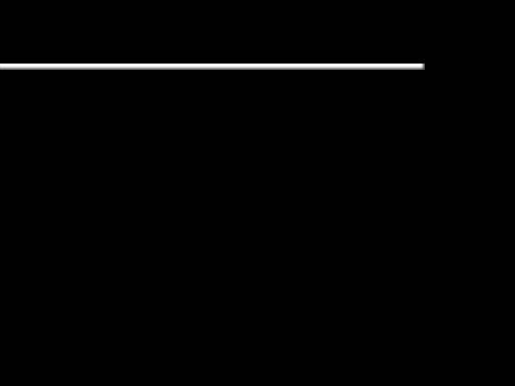
O Come All Ye Faithful
O come, all ye faithful, joyful and triumphant
O come, ye, o come ye to Bethlehem.
Come and behold Him
Born the king of angels

Slide 2
O Come All Ye Faithful
O come let us adore Him,
O come let us adore Him
O come let us adore Him,
Christ, my Lord

Slide 3
O Come All Ye Faithful
Sing, choirs of angels, sing in exultation;
O sing, all ye citizens of heaven above!
Glory to God, all glory in the highest

Slide 4
O Come All Ye Faithful
O come let us adore Him,
O come let us adore Him
O come let us adore Him,
Christ, my Lord

Slide 5
O Come All Ye Faithful
O come, all ye faithful, joyful and triumphant
O come, ye, o come ye to Bethlehem.
Come and behold Him
Born the king of angels

Slide 6
O Come All Ye Faithful
O come let us adore Him,
O come let us adore Him
O come let us adore Him,
Christ, my Lord

